Slide 1
ML Assignment 1
Exploratory Data Analysis of Udemy Courses

Slide 2

. Avirup Aditya . Sai Lohith Nagarikanti . Shubhi Yadav . Jilla Venkata Surya . Rahul Kumar . Charan Sai . Divya Ann Kurien . Shakti Yadav . Laharish Reddy
Team Memebers

Slide 3
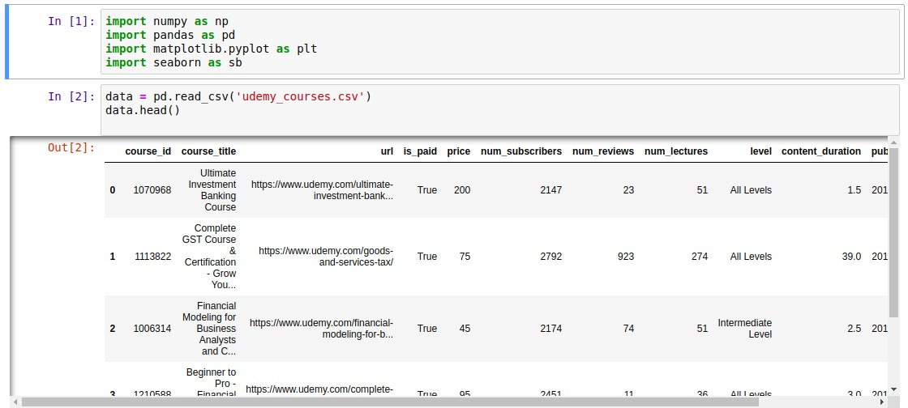
Importing libraries
Importing “udemy_courses.csv” file using pandas library.

Slide 4
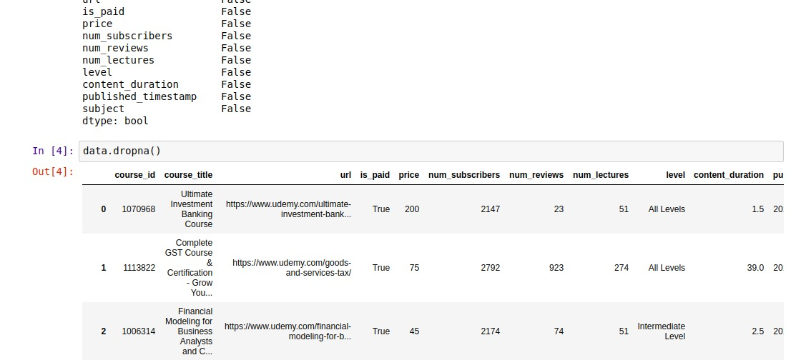
Checking for null values.
dropna() returns the data frame after filtering null values.

Slide 5
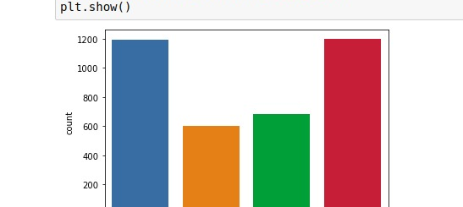
Count of courses in each domain
X = “Subject”
Y = “no. of available courses”

Slide 6
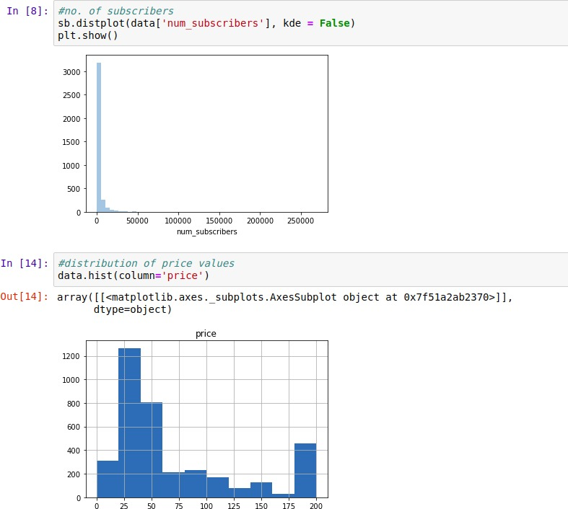
Distribution of price values using data.hist()
Use of matplotlib library to plot graph

Slide 7
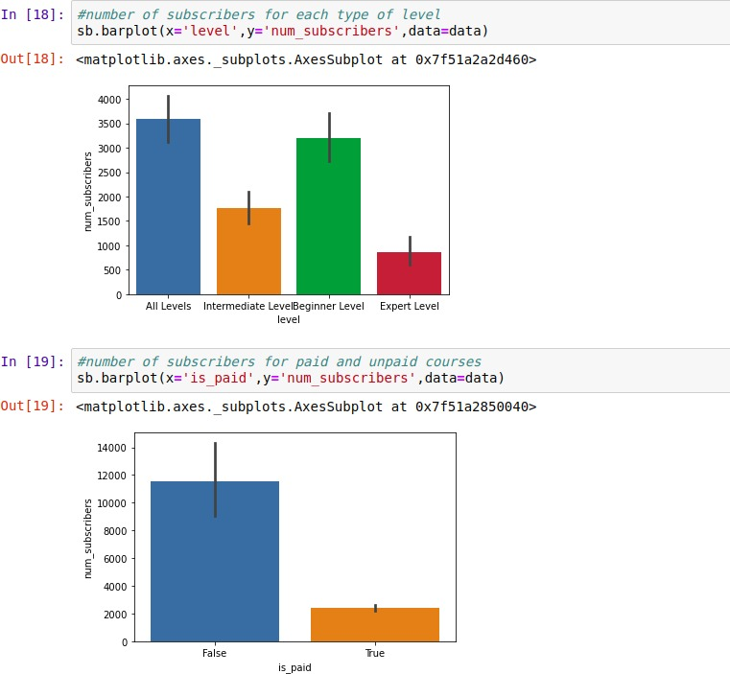
barplot() plots a graph of x = “paid courses” Vs y = “no. of subscribers”

Slide 8
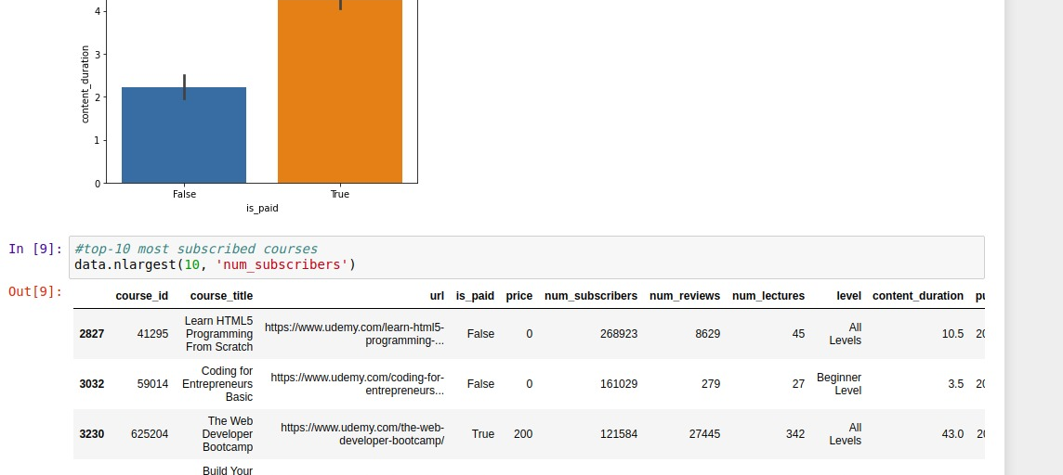
data.nlargest(n, x) calculates top “n” most subscribed courses
A list with top 10 courses , and their features is the output

Slide 9
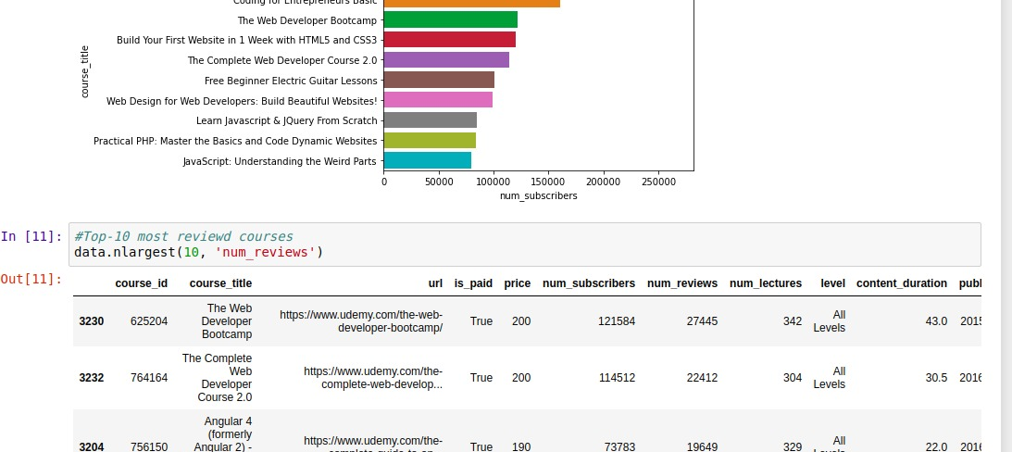
data.nlargest(n, x) returns top 10 most reviewd courses

Slide 10
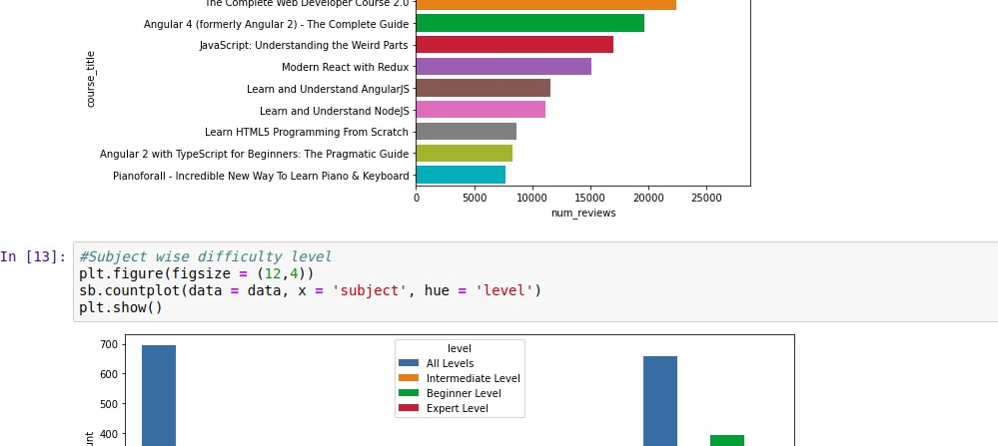
countplot() plots subjects according to difficulty level.

